Slide 1

CMA 2013 – Trash-it presents trash-it
A crowd-sourced Garbage Management app for Android

Slide 2
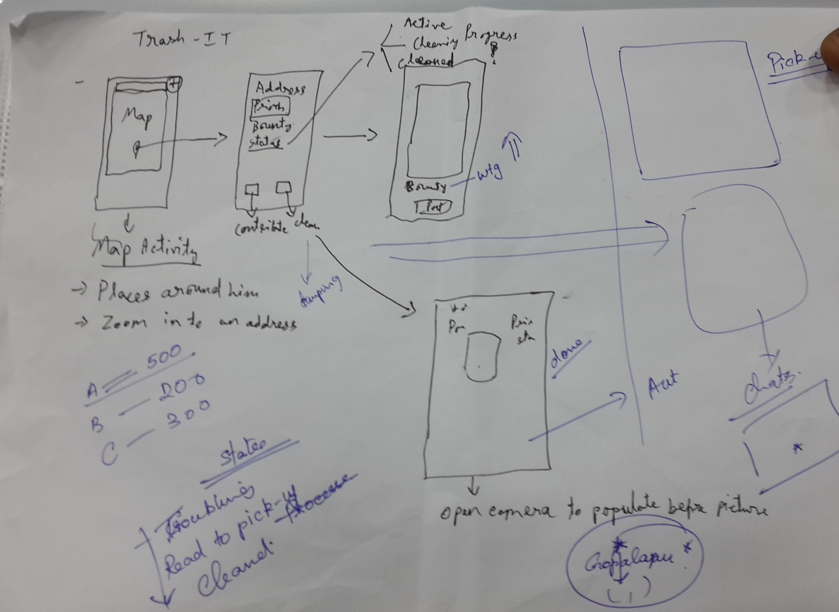

Slide 3
Motivation
Garbage garbage everywhere!!!
Not enough Community workers
Cannot track garbage generation
People willing to do something about it

Slide 4
Crowdsourcing is key
Tag garbage with Photographs
Assign bounty
Claim bounty by clearing garbage
Verification by photograph
It doesn’t stop there

Slide 6
Data, data, data …
Useful for
Civic authorities
Real Estate agents
Tourists
…

Slide 7
DEMO
To see is to believe

Slide 8
Widescreen Test Pattern (16:9)
Aspect Ratio Test
(Should appear circular)
4x3
16x9

